Slide 1
COMP 90018 Mobile Computing Systems Programming
Tutorial on Android Development
Chu Luo, Ransi De Silva
chu.luo@unimelb.edu.au
ransidesilva@gmail.com

Slide 2
Welcome!
Outcomes of this tutorial:
Use SQLite Database on Android
Use Content Provider
Project Help

Slide 3
1. SQLite
Open source SQL database via text file on a device.
Built in SQLite database implementation.
SQLite supports all the relational database features.
No need to establish any connections, (like JDBC,ODBC )

Slide 4
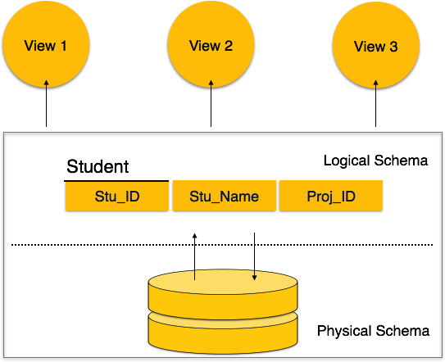
Design a Schema First
Describe
your data

Slide 5
Question
How do you design a DB Schema?

Slide 6
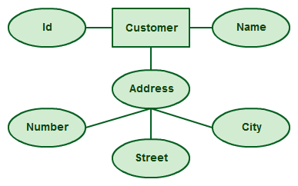
E.g., Using ER Diagram

Slide 7
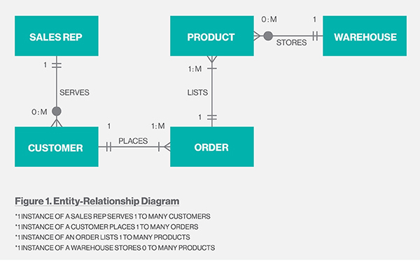
Create table
Create table
Also create a table for relation

Slide 8
Android API for SQLite
https://developer.android.com/training/data-storage/sqlite

Slide 9
To create DB:
To create table & Insert:
SQLiteDatabase mydatabase = openOrCreateDatabase("your database name", MODE_PRIVATE,null);
mydatabase.execSQL("CREATE TABLE IF NOT EXISTS table_name(Username VARCHAR,Password VARCHAR);");
mydatabase.execSQL("INSERT INTO table_name VALUES('admin','admin');");

Slide 10
To retrieve:
Cursor resultSet = mydatbase.rawQuery("Select * from table_name",null); resultSet.moveToFirst(); String username = resultSet.getString(0); String password = resultSet.getString(1);
Other functions like: getCount(), getColumnCount(), getColumnIndex(String columnName), getColumnName(int columnIndex), getPosition(), ..

Slide 11
Question
How to avoid SQL code every time of data management?

Slide 12
Using SQLiteOpenHelper:
SQLiteOpenHelper encapsulates the SQL code to manipulate data
So you can just call a function with parameters to manage data

Slide 13
Using SQLiteOpenHelper:
E.g., inserting data using this. No longer need to write SQL

Slide 14
Question
How to access data between apps on the same device?
E.g., note that a database can only be accessed by the app creating it

Slide 15
2. Content Provider
To share and abstract data access

Slide 16
Four Components in Android Apps
Activity: foreground program
Service: background task
Broadcast Receiver: respond to events
Content Provider: share/manage data on phone storage (or anywhere)

Slide 17
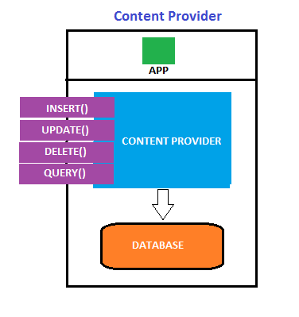
Content Provider
Mostly, for App
to access
Database

Slide 18
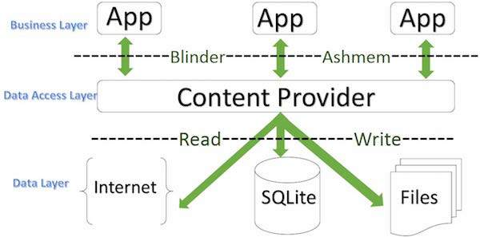
Content Provider Component
Data sharing across apps

Slide 19
Question
How do you identify a Content Provider?

Slide 20
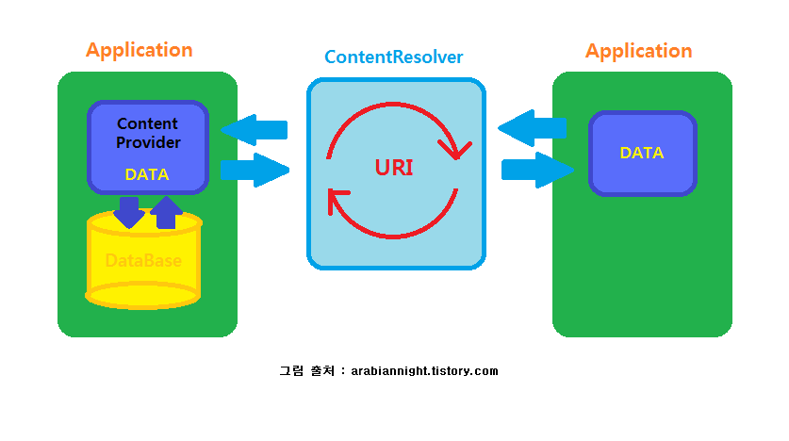
URIs: For Identification

Slide 21
Content URIs
To query a content provider, you specify the query string in the form of a URI which has following format
content://<authority>/<data_type>/<id>
This specifies the name of the content provider, for example contacts,
specific record requested
type of data that this particular provider provides

Slide 22
Create Content Provider
Create a Content Provider class that extends the ContentProvider baseclass.
Define your content provider URI address, which will be used to access the content.

Slide 23
3. Create your own database (onCreate()) to keep the content (e.g., SQLite, use SQLite Open Helper method to create/open the provider's database.).
4. Implement Content Provider queries to perform database operations.
5. Register your Content Provider in your AndroidManifest.xml using <provider> tag.

Slide 24
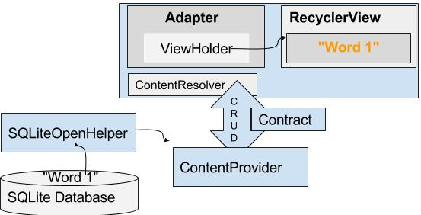
Connect CP and DB
SQLite can use Helper with this

Slide 25
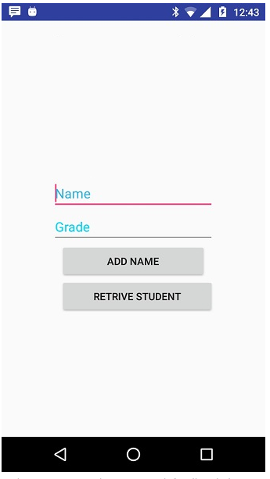
Demo/ Exercise:
Creates a basic Students Provider application that allows insertion, deletion and modification of student info using SQLite.

Slide 26
More to Learn:
Synchronise device data with cloud data in different network states

Slide 27
What About Next Week?
Project Help

Slide 28
See you next week COMP 90018
Tutorial on Android Development
Chu Luo, Ransi De Silva
chu.luo@unimelb.edu.au
ransidesilva@gmail.com

